Slide 1
EYE GAZE TRACKING ​
EYE GAZE TRACKING ​
Under the guidance of
Prof. Shashidhar R
Assistant Professor
JSS S&T Univ,
Mysuru
Presented by,
Conjeevaram Shravan– 01JST18EC028
Sumantha Prabhu– 01JST18EC117
Mohamed Fazal Farhan - 01JST18EC055
Madhusudhan R-01JST18EC52

Slide 2
CONTENTS
Introduction
Literature survey
Objectives
Methodology
Result and discussion
Conclusion and Future scope
References

Slide 3
INTRODUCTION
The localization of eye centers has significant importance in many computer vision applications such as human-computer interaction, face recognition, face matching, user attention or gaze estimation. There are several techniques for eye center localization, some of them make use of a head mounted device, others utilize a chin rest to limit head movements. Moreover, active infrared illumination is used to estimate the eye centers accurately through corneal reflections. Although these techniques allow for very accurate predictions of the eye centers and are often employed in commercial eye-gaze trackers, they are uncomfortable and less robust in daylight applications and outdoor scenarios. Therefore, available light methods for eye Centre detection have been proposed. These methods can roughly be divided into three groups: (i) feature-based methods, (ii) model-based methods, and (iii) hybrid methods. In this project we describe a feature-based approach for eye center localization that can efficiently and accurately locate and track eye centers in low resolution images and videos, e.g., in videos taken with a webcam. We follow a multi-stage scheme that is usually performed for feature-based eye Centre localization (see Figure 1), and we make the following contributions: (i) a novel approach for eye Centre localization, which defines the Centre of a (semi-)circular pattern as the location where most of the image gradients intersect.

Slide 4
LITERATURE SURVEY
As we all know that that there has been tremendous difficulty for specially abled to use new day technology like laptop mobile phone and another personal computer. But the advancement in the technology has brought to a verge where the computer can be used without physically without moving a kind of objects. This recent advancement has motivated us to design and implement a solution with which a personal and industrial computer can be used without contact with appreciably its high accuracy. We are creating a software stack which grabs eye gaze process it using digital image processing techniques and move the cursor on the screen relative to position in the eyeball.
We want this solution to be accurate and precise enough for day-to-day use. We also want to reduce the cost of building and maintaining software solution with latest robust technology.

Slide 5
Paper Title | Method | Merits | Demerits
Shih S.-W., Liu J. A novel approach to 3-D gaze tracking using stereo cameras. Trans. Sys. Man Cyber. Part B. 2004;34:234–245. doi: 10.1109/TSMCB.2003.811128. | Uses a Model Based Approach | ●In a model-based technique, the corneal center, which is the point of intersection of visual and optical axes, is considered as an important parameter for gaze estimation. If the corneal curvature is already known, it is possible to determine the corneal center with the help of two light sources and a camera. | ● For estimation of corneal curvature, anthropomorphic averages are usually adopted due to their simplicity and ease of use. However, if the eye-related parameters are unidentified, at least two cameras and two light sources are required to estimate the corneal center. Several studies, such as used model-based techniques in a fully calibrated arrangement. At a minimum, a single point of calibration is mandatory to estimate the angle between the visual and optical axes..
Hansen D.W., Hansen J.P., Nielsen M., Johansen A.S., Stegmann M.B. Eye typing using Markov and active appearance models; Proceedings of the Sixth IEEE Workshop on Applications of Computer Vision (WACV 2002); Orlando, FL, USA. 4 December 2002; pp. 132–136. | Single-glint techniques | ●In initial gaze tracking applications, a single source of IR light was employed to enhance the contrast and consequently produce stable gaze estimates. ● Many single-glint techniques were implicitly based on an erroneous assumption that “the corneal surface is a perfect mirror.” | This assumption inferred that the glint should remain stationary as long as the head position is fixed even when the corneal surface rotates. Therefore, the glint is taken as the origin in glint-centered coordinate systems. In this view, the difference between the pupil center and the glint is utilized to estimate the gaze direction.

Slide 6
A precise and inexpensive magnetic field search coil system for measuring eye and head movements. | Scleral Search Coils | The advantage of such a method is the high accuracy and the nearly unlimited resolution in time. | It is an invasive method, requiring something to be placed into the eyes. To the best of our knowledge, this method of eye tracking has not been used for HCI by gaze, so far. This method is mostly used in medical and psychological research.
https://www.researchgate.net/publication/327578844_ELECTROOCULOGRAPHY_ANALYSIS_ON_DEVICE_CONTROL_BY_SIGNAL_PROCESSING | ELECTRO OCULOGRAPHY | ●Sensors are attached at the skin around the eyes to measure if an electric field exists when eyes rotate. ●It is a cheap, easy and invasive method of recording large eye movements. ●By recording small differences in the skin potential around the eye, the position of the eye can be estimated. By carefully placing electrodes, it is possible to separately record horizontal and vertical movements. | ●However, the signal can change when there is no eye movement. ●This technique is not well-suited for everyday use, since it requires the close contact of electrodes to the user but is still frequently used by clinicians.
Pérez, A & Córdoba, Mª & Garcia-Dopico, Antonio & Méndez, R & Muñoz, Maria & Pedraza, J.L. & Sánchez, F. (2003). A precise eye-gaze detection and tracking system. | Infrared Oculography | ●The light source and sensors can be placed on spherical glasses. Hence it is an invasive method. The infrared oculography has less noise than electro-oculography, but is more sensitive to changes of external light tension. | ●The main disadvantage of this method is that it can measure eye movement only for about ±35 degrees along the horizontal axis and ±20 degrees along the vertical axis. .

Slide 7
OBJECTIVES
Provide a cheap eye-tracking system. ​
To control the cursor of a computer with eyes. ​
Allow physically disabled people to use computers. ​
To control a computer and communicate with other systems. ​
To provide a real-time accurate eyes gesture control system. ​
To provide a hand free mouse control system. ​
To provide a complete generic eye-gesture mouse control system. ​
To provide a complete wire free mouse control system. ​
Easy to control cursor movement of a mouse.​

Slide 8
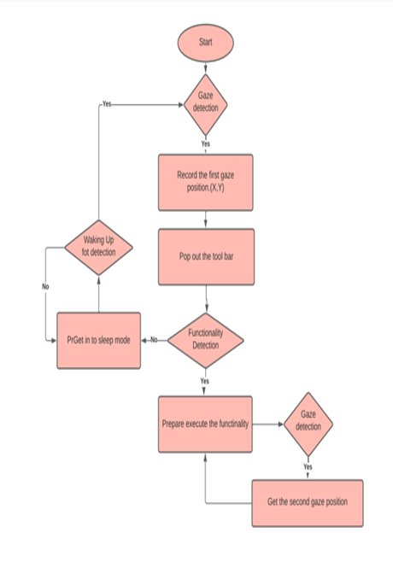
METHODOLOGY:

Slide 9
Algorithm
Step 1: The image of the user is captured using the laptop/computer using the open source library called as OpenCV in Python.
Step 2: The captured image is preprocessed and fed into the library to extract the face from the image. The library that provides this framework is written in C++ and is called as dlib.
Step 3: The approximate positions of the eyes is captured from the extracted face using the various facial features.
Step 4: The Fabian-Timm algorithm is applied on the extracted eyes to find the exact position of the iris in both the eyeballs.
Step 5: Two variables are calculated from the relative positions of the eyes as perceived from the camera. The variables are horizontal & vertical ratios.
Step 6: The two ratios calculated are then mapped to the relative coordinates on the screen.
Step 7: The computer’s cursor is then moved to the absolute position on the screen as perceived from the camera.

Slide 10
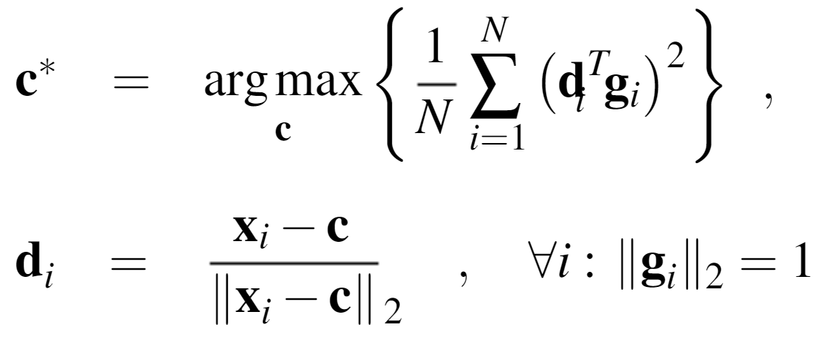
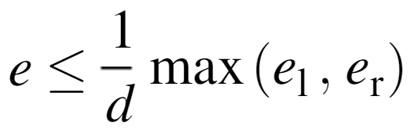
c be a possible centre
gi the gradient vector at position xi on the image.
di is the normalised displacement vector.
c* is the optimal center of the circular object in the image which here is the center of eye.
As accuracy measure for the estimated eye centres, we evaluate the normalised error.
el, er are the Euclidean distances between the estimated and the correct left and right eye centres, and d is the distance between the correct eye centres.

Slide 11
RESULT AND DISCUSSION
The ability to evaluate algorithms is essential to compare performance of different algorithms and techniques, and to identify their weak spots. However, this issue is highly problematic in the the eye gaze tracking, due to the lack of accepted test protocols, performance metrics and public data sets. Many papers report their results in terms of efficiency only, but the complete breakdown of number of frames tested, the number of successful detection in frames and number of failure frames are not clearly quoted for the existing methods.

Slide 12
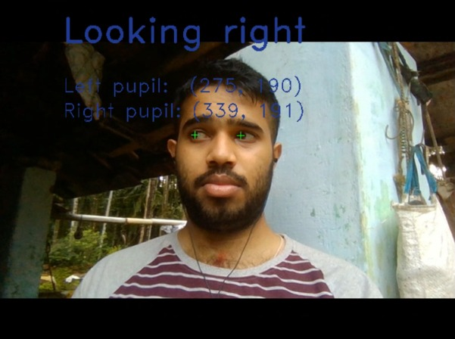
RESULT AND DISCUSSION

Slide 13
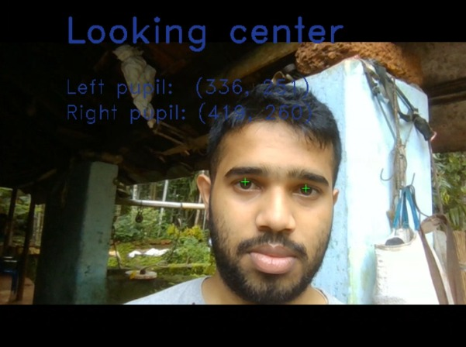
RESULT AND DISCUSSION

Slide 14
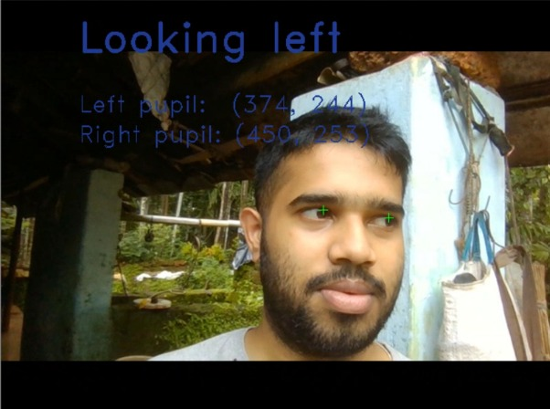
RESULT AND DISCUSSION

Slide 15
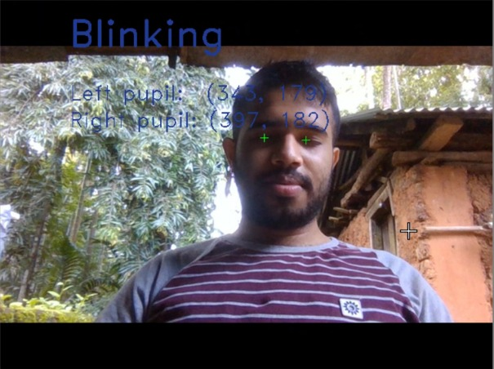
RESULT AND DISCUSSION

Slide 16
CONCLUSION
We have presented a brief introduction to eye tracking as a technique and shown how the different types of eye trackers can be incorporated into setups used to investigate human interaction.
Following, a scoping overview of the eye-tracking literature in human interaction was provided and several studies were reviewed and categorized depending on the amount and type of eye trackers used.

Slide 17
Future Scope
The algorithm to detect blinking can be further improved and used for implementing clicking.
As of now, the clicking algorithm is very raw and causes the program to perform random clicks which is pretty dangerous.

Slide 18
Future Scope
Further this algorithm can be compiled and deployed as an app so that the installation and usage experience by the paralised people can be further improved.

Slide 19
In this design, the application distance between the user’s head and the screen is fixed during the operation, and the direction of the head pose tries to keep fixed. In future works, a head movement compensation function will be added, and the proposed wearable gaze tracker will be more convenient and friendly for practical uses. To raise the high-precision recognition ability of the pupil location and tracking, the deep-learning model will be updated with online training using the big image databases in the cloud to fit the pupil position for different eye colors and eye textures.

Slide 20
Thank You

